Slide 1

FIRE DETECTION USING GSM

Slide 2

Whoa!
TEAM MEMBERS
NARESH RAO SS
NAVYA D S
NOOR AYESHA
KAYNA N

Slide 3

“
“ The Internet of Things is not a concept; it is a network, the true technology-enabled Network of all networks.”
—Edewede Oriwoh

Slide 4
01
02
04
Agenda
03
Problem Statement
Introduction
Components & Circuit Diagram
Conclusion

Slide 5
INTRODUCTION

Slide 6

Fire detection systems are designed to discover fires early in their development when time will still be available for the safe evacuation of occupants.
Early detection also plays a significant role in protecting the safety of emergency response personnel.

Slide 7
PROBLEM STATEMENT

Slide 8
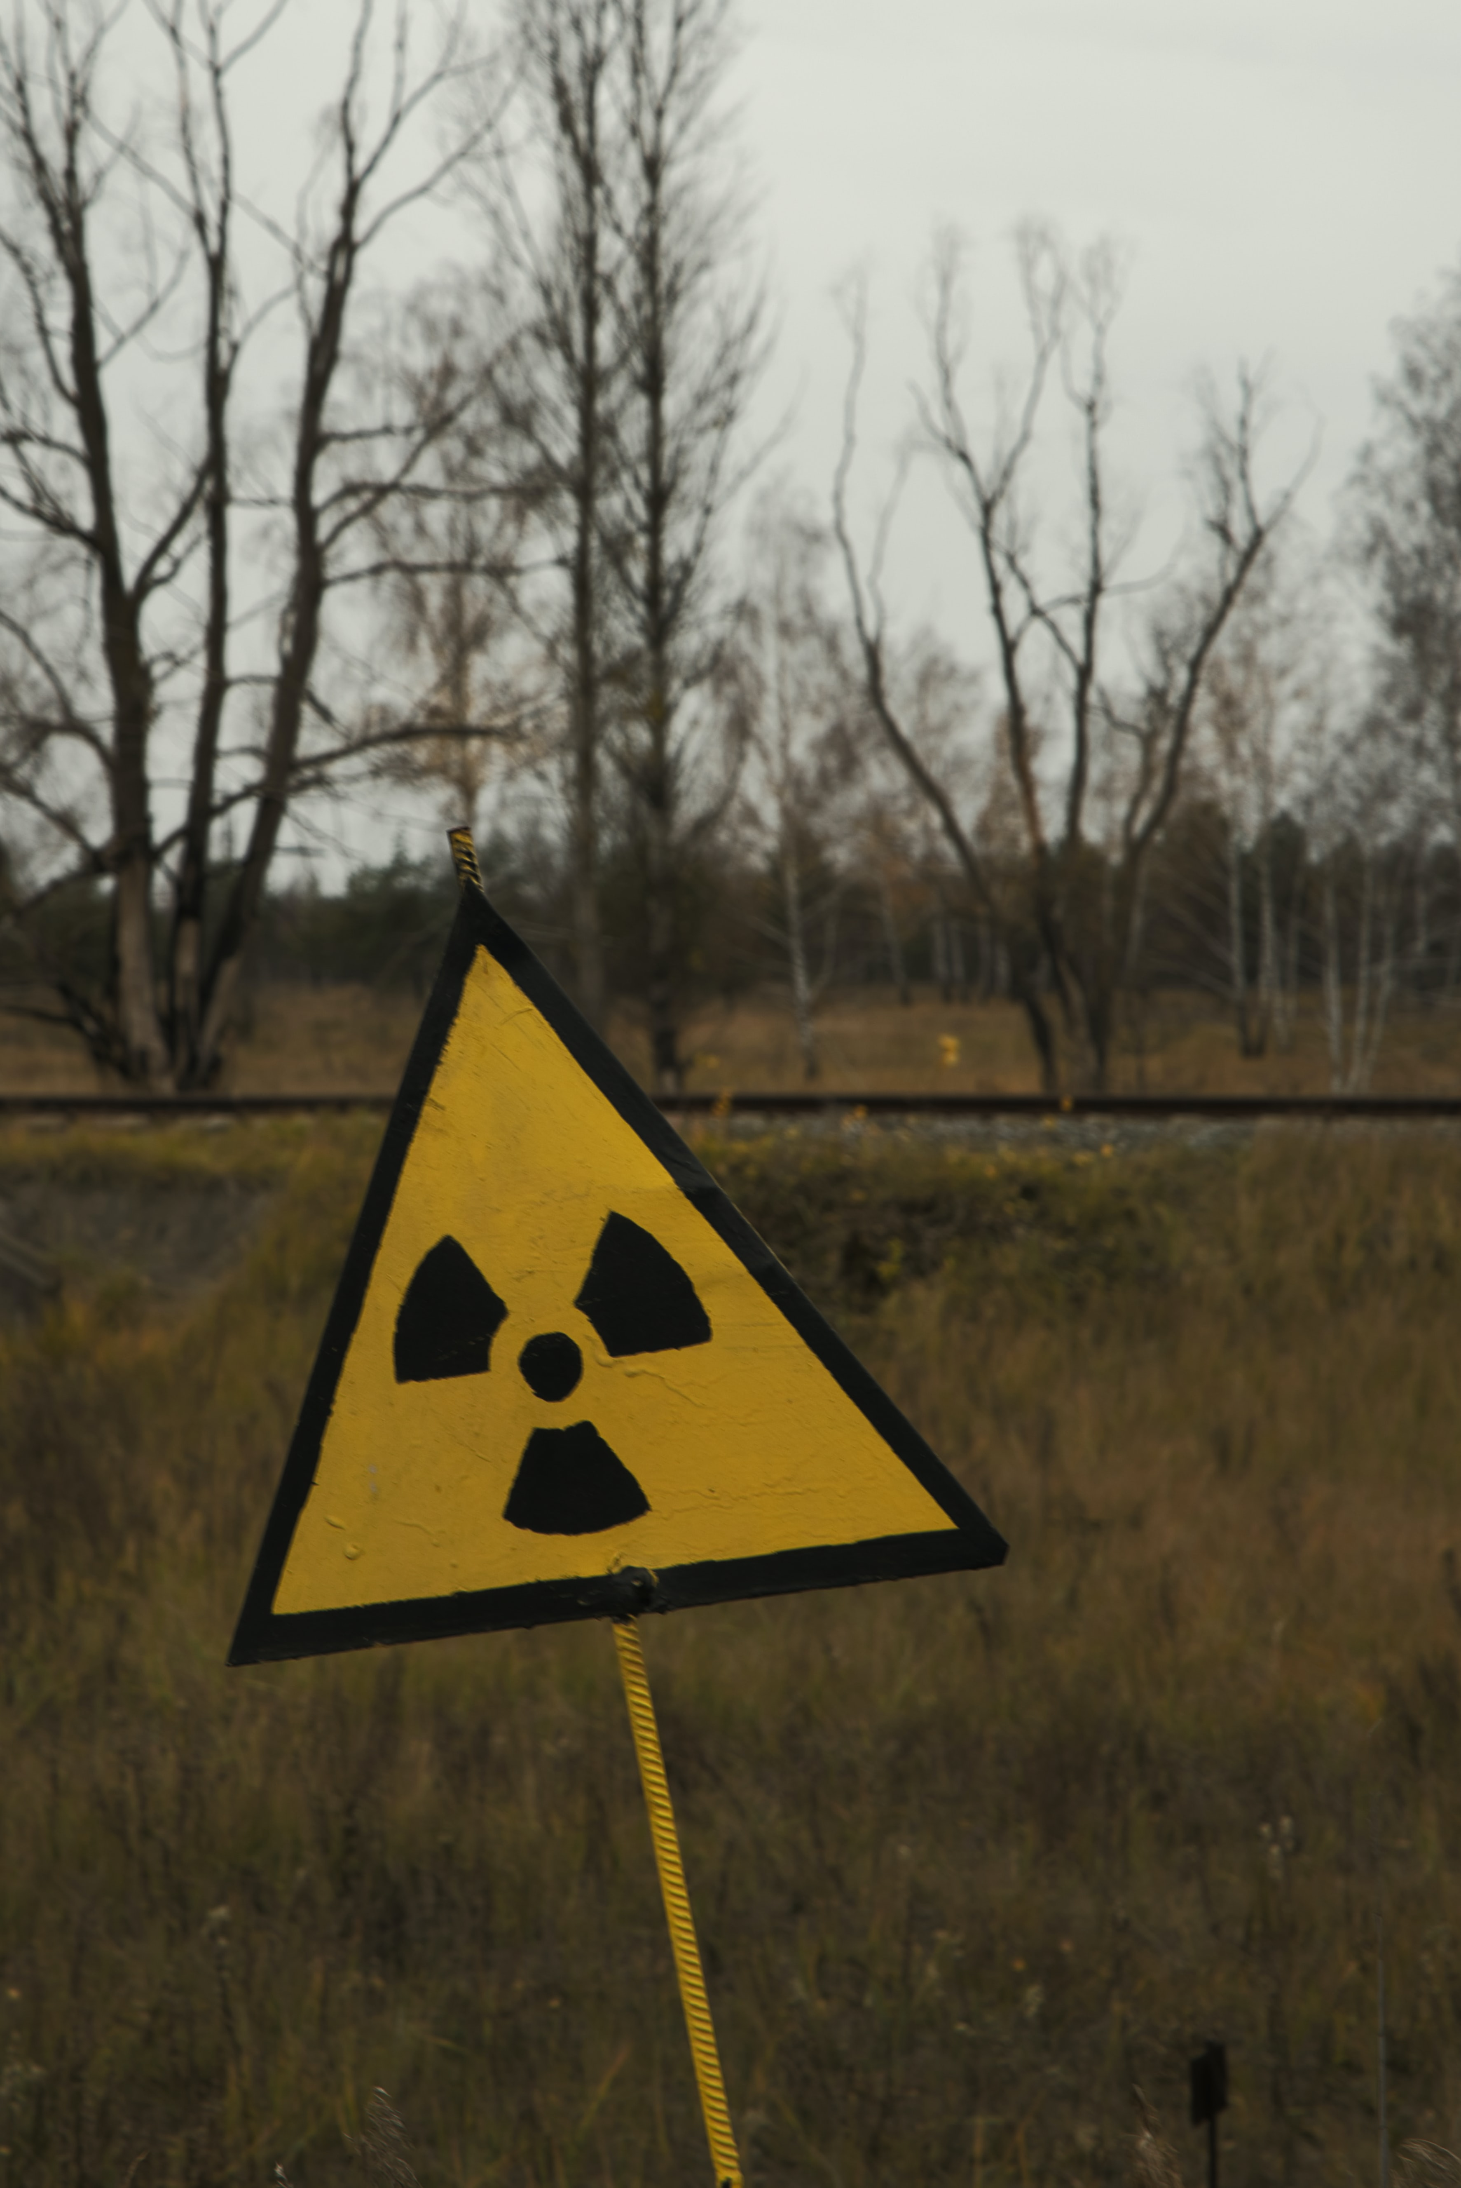
Fire detection is most very important in organization firms which helps to detect if there is smoke or fire in the building and alerts with a buzzer.
Using a GSM module which is used to send alerts via SMS and Call to the corresponding number given at initial stage while writing down the code.

Slide 9
COMPONENTS & COST ESTIMATION

Slide 10
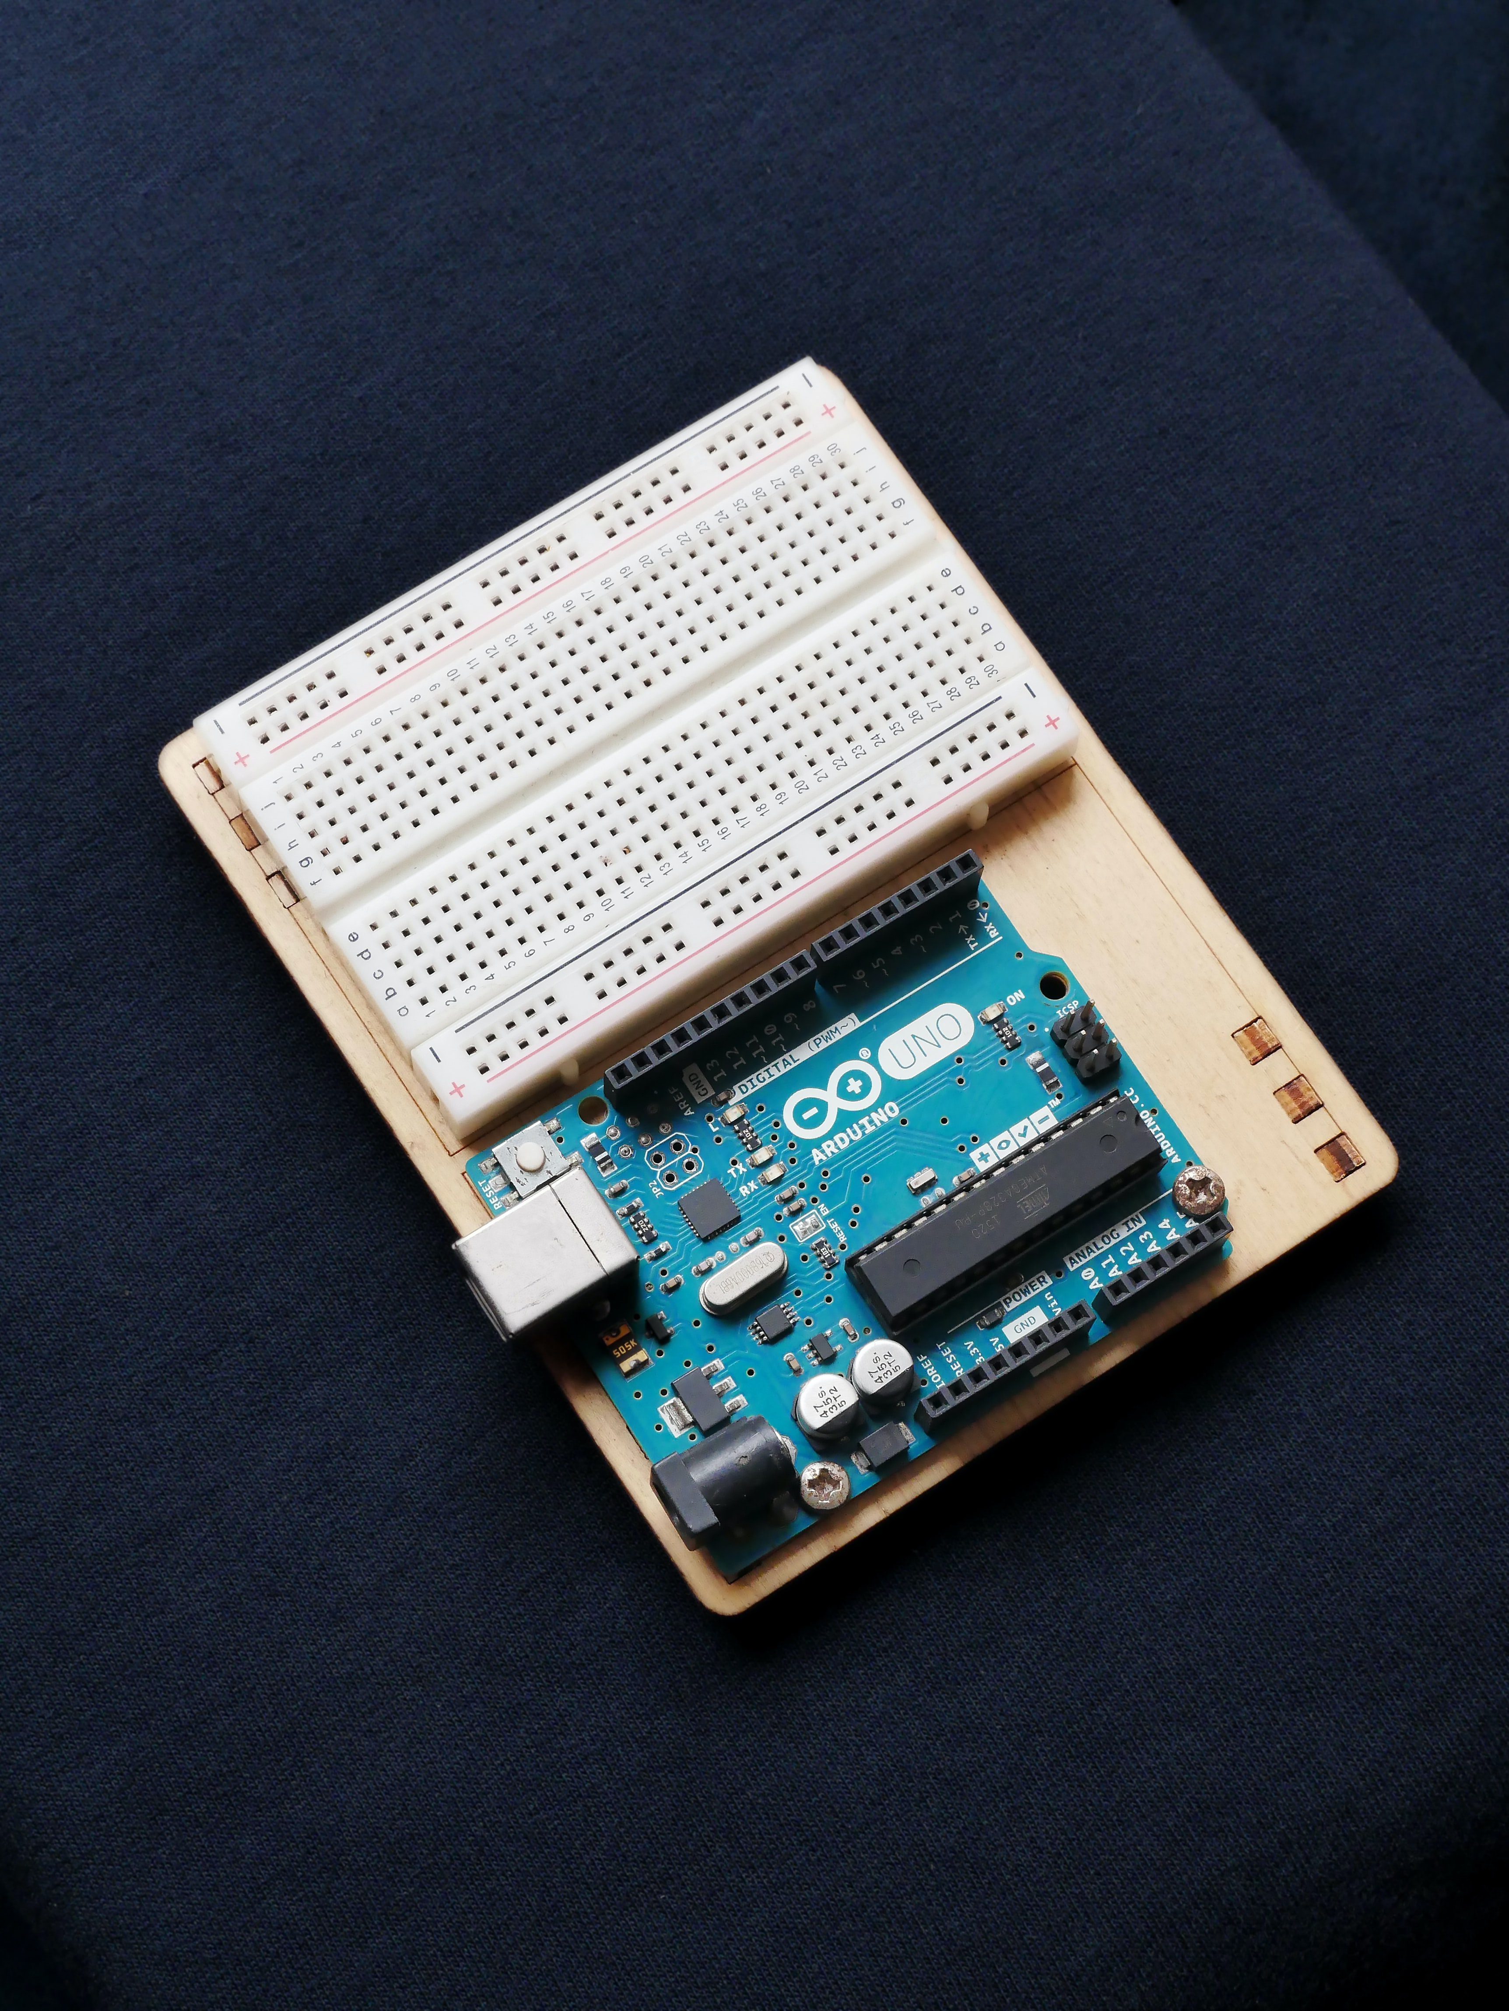
Arduino UNO - 750rs
LED Lights - 20rs
Breadboard - 180rs
Buzzer - 50rs
Flame sensor - 170rs
Jump Wires - 150rs
GSM Module - 800rs
DC 5V 2A Adaptor Plug – 100rs

Slide 11
SYSTEM PREREQUISITE

Slide 12
Software used
Arduino 1.8.15
Personal Computer
Windows 7 or Above
32 bit or 64 bit
C programming

Slide 13
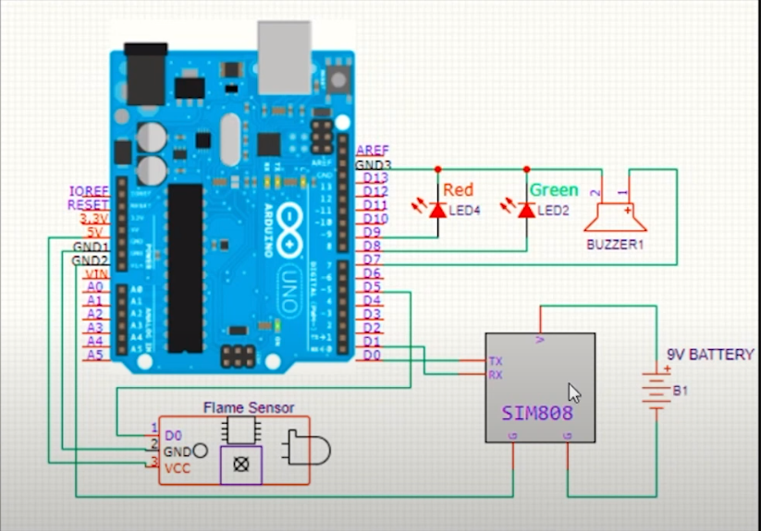

Slide 14
CONCLUSION

Slide 15

Internet of Things is the concept in which the virtual world of information technology connected to the real world of things. The technologies of Internet of things such as Sensor make our life become better and more comfortable.
Since Engineers are meant to make things simpler and easy in handling things so there is no confusion at users end in understanding and simply using the product manufactured.

Slide 16
Complete Process Beginning - End
Team
Gathering of team memebers was initially
For the IoT Project Task
Problem Identification
Smoke detection system
Components
purchasing useful component from store
Conclusion
Testing and checking if everything is working properly or not.

Slide 17


